Slide 1
Graph Databases
Pravin Y Pawar

Slide 2
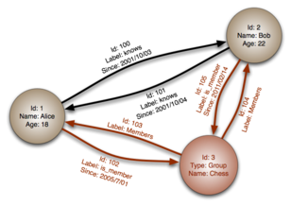
Graph Based Databases
A graph is a pictorial representation of a set of objects where some pairs of objects are connected by links
composed of two elements - nodes (vertices) and relationships (edges)
Data is represented as graphs and related nodes can be found by traversing the edges using the path expression
Nodes and edges can be labelled to indicate types of entities and relationships they represent
aka network database
Example
Neo4J
HyperGraphDB
GraphBase

Slide 3
Why Graph Databases?
Most of the data exists in the form of the relationship between different objects
Often the relationship between the data is more valuable than the data itself
Relational databases store highly structured data
do not store the relationships between the data
Graph databases store relationships and connections as first-class entities
The data model for graph databases is simpler compared to other databases
can be used with OLTP systems
provide features like transactional integrity and operational availability

Slide 4
RDBMS Vs Graph Database
RDBMS | Graph Databases
Tables | Graphs
Rows | Nodes
Columns and data | Properties and values
Constraints | Relationships

Slide 5

Neo4j
Open source
Implemented in Java
Supports query language – Cypher
The world's leading open source Graph Database
Highly scalable and schema free (NoSQL)
ACID-compliant transactional database with native graph storage and processing
Neo4j is available in a GPL3-licensed open-source "community edition“
with online backup and high availability extensions licensed under a closed-source commercial license

Slide 6
Features of Neo4j
Data model (flexible schema)
Native property graph model, the graph contains nodes (entities) and these nodes are connected with each other (depicted by relationships)
Nodes and relationships store data in key-value pairs known as properties
can add or remove properties as per requirement
ACID properties
supports full ACID (Atomicity, Consistency, Isolation, and Durability) rules
Scalability and reliability
Can scale the database by increasing the number of reads/writes, and the volume without effecting the query processing speed and data integrity
Provides support for replication for data safety and reliability

Slide 7
Features of Neo4j (2)
Cypher Query Language
Provides a powerful declarative query language known as Cypher
Cypher is easy to learn and can be used to create and retrieve relations between data without using the complex queries like Joins
Built-in web application
Provides a built-in Neo4j Browser web application
Can create and query graph data
Can work with
REST API to work with Java, Spring, Scala etc.
Java Script to work with UI MVC frameworks such as Node JS

Slide 8
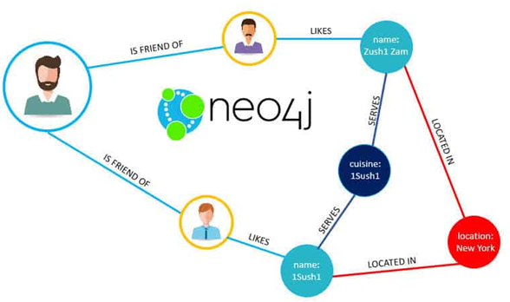
Neo4j Property Graph Data Model
Follows the Property Graph Model to store and manage its data
Key features of Property Graph Model
The model represents data in Nodes, Relationships and Properties
Properties are key-value pairs
Both Nodes and Relationships contain properties
Nodes are represented using circle
Relationships are represented using arrows (Unidirectional and Bidirectional)

Slide 9
Neo4j CQL
CQL stands for Cypher Query Language
Neo4j CQL
Is a declarative pattern-matching language
Follows SQL like syntax
Syntax is very simple and in human readable format
Like SQL, Neo4j CQL
has commands to perform Database operations.
supports many clauses such as WHERE, ORDER BY, etc., to write very complex queries in an easy manner
supports some functions such as String, Aggregation
supports some Relationship Functions

Slide 10
Thank You!
In our next session:

